Slide 1
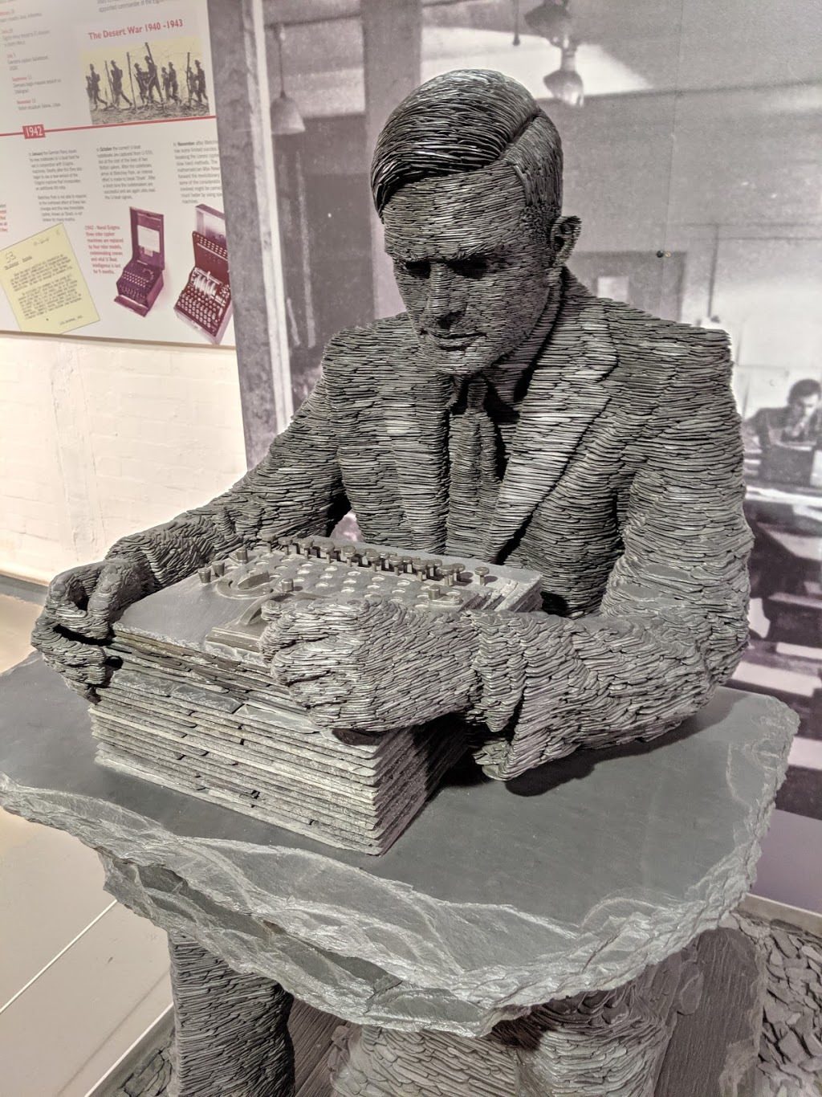
Software Development Lifecycle (SDLC) Models
Dr. Jason B. Shepherd

Slide 2
Have you ever…
… started work on a project and after a couple of weeks realized you didn’t fully understand what you were supposed to build?
… worked on a project and then near the deadline realized you didn’t have enough time to finish it?

Slide 3
What is a process?
Collection of activities
Requirements, Design, Implementation, Testing, Deployment, Maintenance
Controls how project is developed, increasing quality and likelihood of success
Manage resources
Communication
With customers and users
Between developers

Slide 4
What is a process model?
Determines the order of stages involved in software development and evolution
Establishes transition criteria for moving from one stage to the next
Synonymous with lifecycle model

Slide 5
Challenges
Customers often don’t know what they want exactly
Customers have vague idea of problem to be solved, but is unable to translate this into precisely defined goals
Customers have difficulty predicting what system should do in the future
Software engineers may have little to no experience with the business domain

Slide 6
Major activities found in any process
Feasibility study
Requirements definition
Software architecture (high-level)
Software design (more detailed)
Coding and module testing
Integration and system testing
Delivery, deployment, and maintenance

Slide 7
Waterfall Models
Feasibility study
Requirements
Architecture/design
Coding & module testing
Integration & system testing
Delivery, deployment, & maintenance
Sequential
Phase-based
Document-driven (or, more accurately, artifact-driven)
Inspired by manufacturing

Slide 8
Waterfall Models
Feasibility study
Requirements
Architecture/design
Coding & module testing
Integration & system testing
Delivery, deployment, & maintenance
Each phase has deliverables associated with it
Deliverables signal the transition from one phase to the next
Deliverables are usually reviewed and accepted before going on to the next phase
Deliverables are often a document or code

Slide 9
Critical Evaluation
Feasibility study
Requirements
Architecture/design
Coding & module testing
Integration & system testing
Delivery, deployment, & maintenance
In-class: What can you foresee as drawbacks to a waterfall lifecycle model?

Slide 10
Critical Evaluation
Feasibility study
Requirements
Architecture/design
Coding & module testing
Integration & system testing
Delivery, deployment, & maintenance
Good: we know where we are in development
Good: efficient when requirements are well-understood
Bad: unlikely development will be truly linear
(requirements often not known a priori)

Slide 11
Feedback Loops
Feasibility study
Requirements
Architecture/design
Coding & module testing
Integration & system testing
Delivery, deployment, & maintenance

Slide 12
Rapid Application Development (RAD) Model
Business modeling
Data modeling
Process modeling
Application generation
Testing and delivery
“High speed” adaptation of waterfall model
Rapid development achieved by component-based construction (and advanced tools)
Used to create functional system quickly

Slide 13
Rapid Application Development (RAD) Model
Business modeling
Data modeling
Process modeling
Application generation
Testing and delivery
Requirements must be well understood and project scope constrained
Bad when new technology is introduced
Difficult to performance tune an app in a RAD model

Slide 14
Evolutionary Models
Not sure of requirements?
“Do it twice!” – Fred Brooks
Version 1 is treated as a throwaway
Not “code-and-fix”
Still retains the discipline found in the waterfall model
Developers still know where they are in the process and next steps
Won’t get into them now… names are iterative incremental model, staged delivery model, etc.

Slide 15
Agile Models
Departure from manufacturing paradigm; move to lightweight process
Short iterative cycles and incremental design
Individuals and Interactions over processes and tools
Working Software over comprehensive documentation
Customer Collaboration over contract negotiation
Responding to Change over following a plan
Often involves test-driven development (TDD)
Examples: eXtreme Programming (XP), Scrum, Kanban
From the “Agile Manifesto”

Slide 16
Our Process
Weekly dev cycles using a backlog of “issues”
TDD
User personas and stories
Pair programming
Quality-focus (w/ code reviews)
(Others: cross-functional teams, informative workspaces)

